Slide 1
Ready-to-use setup for high-frequent EnKF assimilation with NorESM2
Ingo bethke^{1,2}
¹University of Bergen
²Bjerknes centre for climate research
EMAIL: ingo.bethke@uib.no

Slide 2
Introduction & first results

Slide 3
DA implementations for NorCPM
Offline (NorESM1,NorESM2)
Stop & restart NorESM and DA seperate executables running sequent.
Disk-based communication between model and DA via modifying full restart files
Components: ocn¹², ice¹ ,lnd¹
DA freq.: monthly (slow model init. & read/write of full restarts)
Semi-online (NorESM2)
Pause & resume (hack) NorESM and DA separate executables running in parallel
Disk-based communication via reading/writing «reduced» restart files
Components: ocn, lnd,(ice,atm)
DA freq.: (sub-)daily, monthly
Online (NorESM2/2.5/3)
Pause & resume (NCAR) DA fully integrated part of NorESM and runs in same job
MPI-based communication between model and DA
Components: ocn, lnd, ice, atm
DA freq.: (sub-)daily, monthly
NEW
COMING SOON
Results on next slides!

Slide 4
Daily ocean data assimilation with NorESM2 (preliminary results)
Test using daily assim. of satellite SSTs and monthly assim. of T/S profiles
Three 10-member ensembles with NorESM2-LM
FREE (no assimilation)
MONTHLY (monthly SST + monthly T/S)
DAILY (daily SST + monthly T/S)
1996-2003 coverage (will only show results from first year)
EnKF anomaly assimilation with 1980-2010 reference period

Slide 5
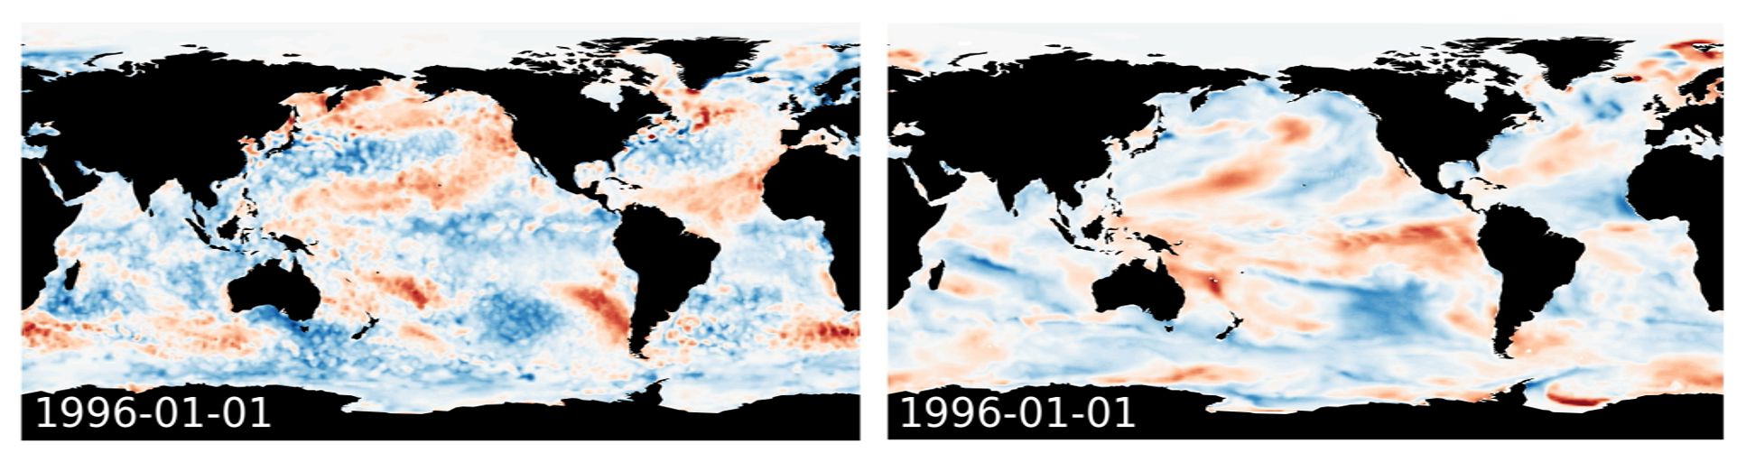
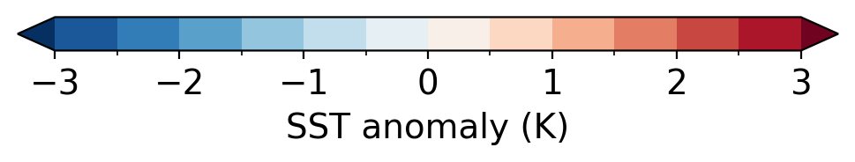
Assimilation of daily SST and monthly T/S observations – obs vs free run
OISST
FREE (member 1)

Slide 6
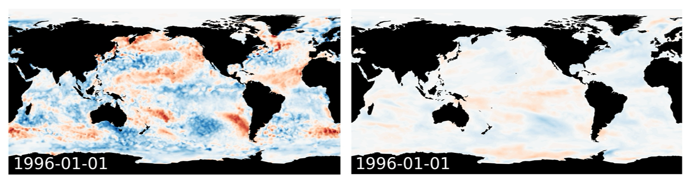
Assimilation of daily SST and monthly T/S observations – obs vs monthly assimilation
OISST
MONTHLY (ensemble mean)

Slide 7
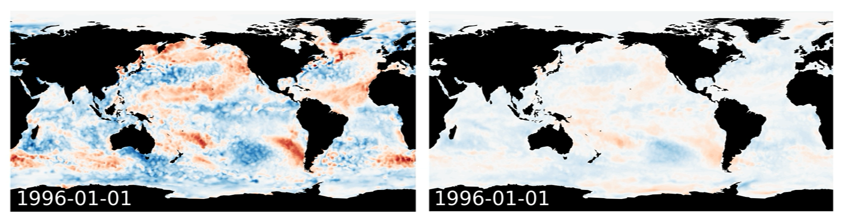
Assimilation of daily SST and monthly T/S observations – obs vs daily assimilation
OISST
DAILY (ensemble mean)

Slide 8
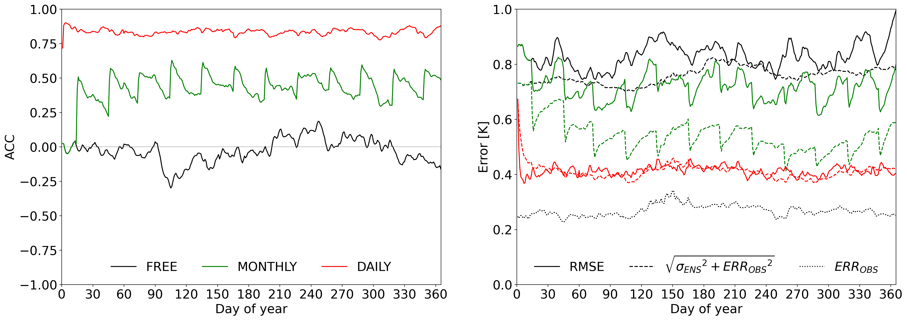
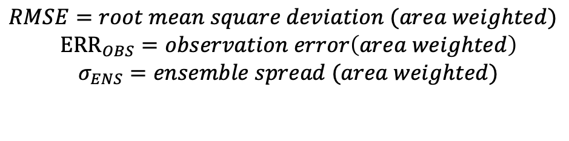
Assimilation of daily SST and monthly T/S observations – global statistics (spatial averages)
$RMSE=root mean square deviation (area weighted)$
$${ERR}_{OBS}=observation error\left(area weighted\right)$$
$$σ_{ENS}=ensemble spread (area weighted)$$
$ACC=pattern correlation (area weighted)$

Slide 9
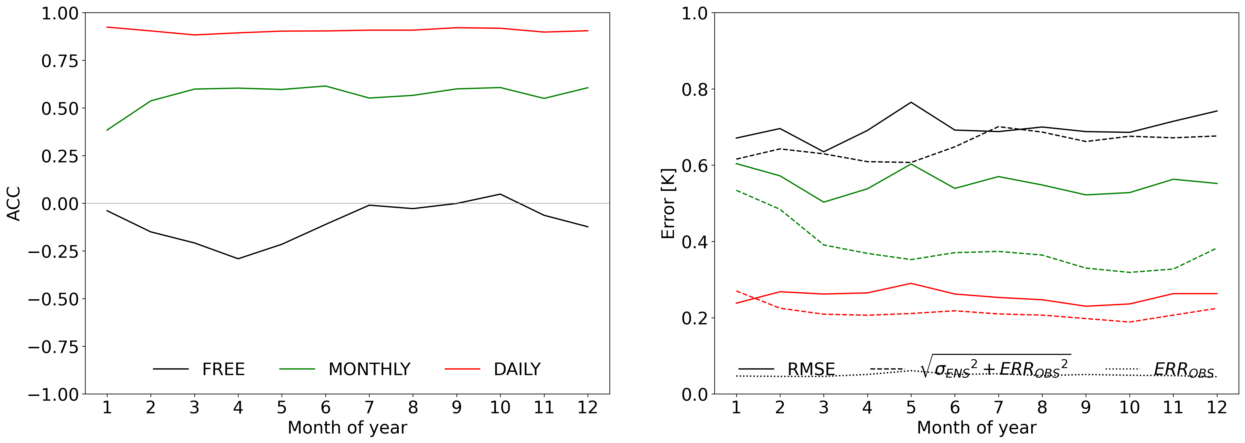
Assimilation of daily SST and monthly T/S observations – global statistics (spatial averages)
$RMSE=root mean square deviation (area weighted)$
$${ERR}_{OBS}=observation error\left(area weighted\right)$$
$$σ_{ENS}=ensemble spread (area weighted)$$
$ACC=pattern correlation (area weighted)$

Slide 10
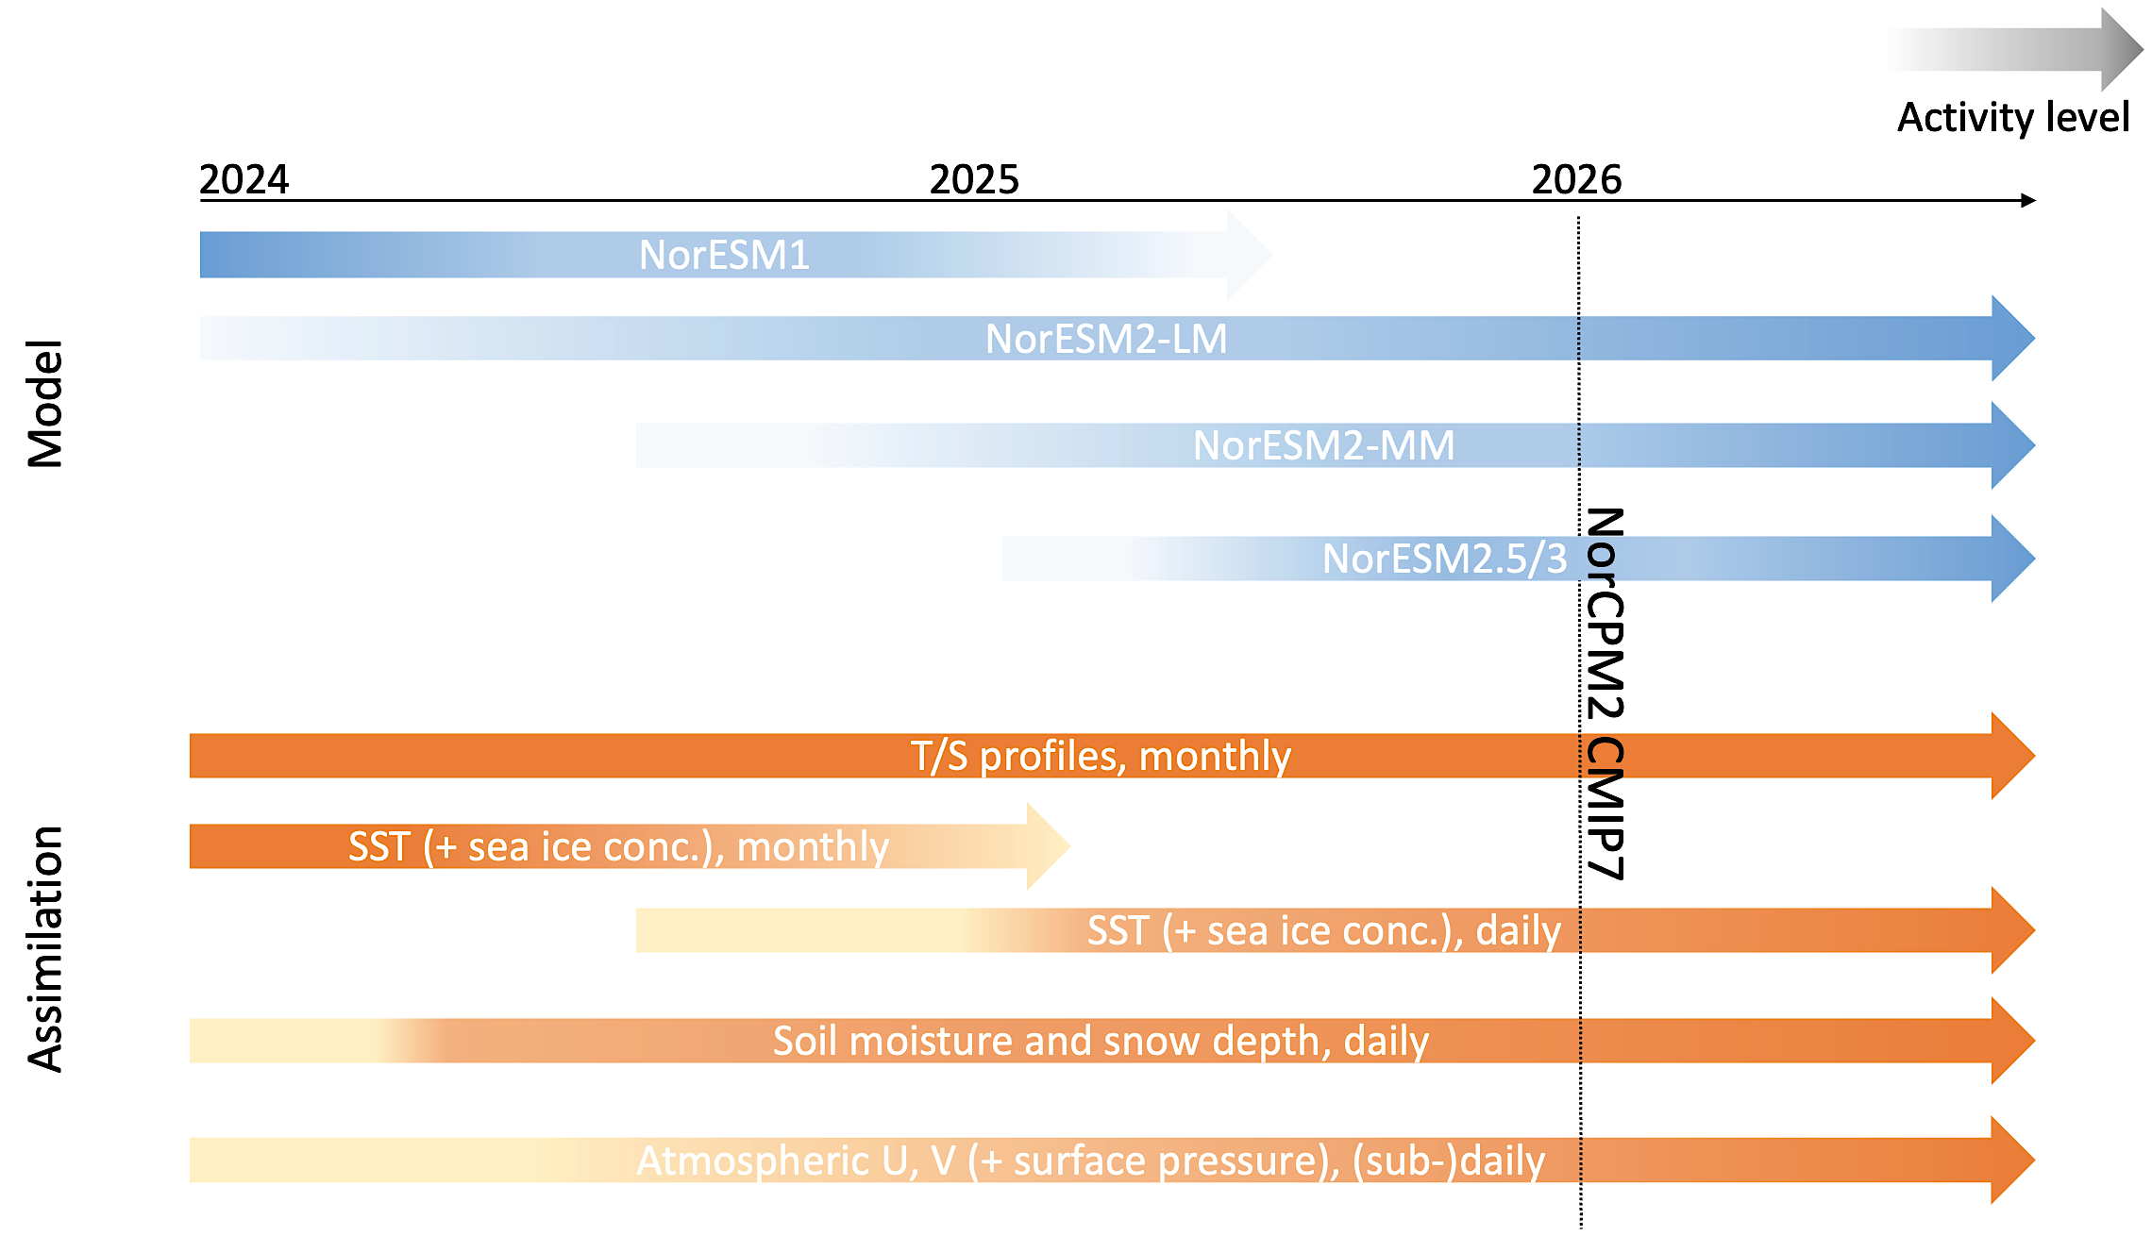
NorCPM roadmap towards DCPP CMIP7

Slide 11
User guide

Slide 12
NorCPM repository with revised structure https://github.com/NorESMhub/NorCPM
supports multiple ESM versions, assimilation schemes and experiment setup environments
multiple users can contribute to the same repository without interfering with each other's work
flexible, well-structured and organized; fully version controlled
suitable for use with NorESM1, NorESM2 and later versions
code1 (e.g. EnKF)
code2 (e.g. prep_obs)
code3 (e.g. micom_init)
…
settings1.in (e.g. analysisfields_1.in)
settings2.in (e.g. enkf.prm_1)
…
assim_build.sh
assim_step.sh
git-controlled
git-controlled?
scheme1
scheme2
myscheme
…
assim
cases
docs
logs
model
setup
tools
noresm1
noresm2
noresm3
mymodel
…
NorCPM
norcpm1-1_historical_18500101_start.sh
norcpm1-1_piControl_18500101_start.sh
norcpm1_piControl_19500101_start.sh
norcpm-cf-system1_assim_19811115_start.sh
norcpm-cf-system1_assim_19811115_continue20220915.sh
norcpm-cf-system1_assimtest_19811115_start.sh
norcpm-cf-system1_hindcast1_20230115_start.sh
setmach.sh
noresm1
noresm2
noresm3
mysetup
…
settings
create_ensemble.sh
submit_ensemble.sh
…

Slide 13
Mini-tutorial for performing a daily assimilation experiment using NorESM2-LM
Install NorCPM in the nn9039k project space
mkdir -p /cluster/projects/nn9039k/people/$USER
cd /cluster/projects/nn9039k/people/$USER
git clone https://github.com/NorESMhub/NorCPM.git NorCPM
Install NorESM2
cd /cluster/projects/nn9039k/people/$USER/NorCPM/setup/noresm2
./install_noresm2.sh
Set up a NorESM2-LM assimilation test experiment with 10 members
./create_ensemble.sh settings/noresm2-lm_odaday_19960101.sh
Submit experiment
./submit_ensemble.sh settings/noresm2-lm_odaday_19960101.sh

Slide 14
Workflow
1
2
create_ensemble.sh <settings file>
submit_ensemble.sh <settings file>
archive_ensemble.sh <settings file>
Login node
Login node
1 task
case.st_archive.sh
Batch system (compute nodes)
run_ensemble.sh
will soon be merged into 1
10-40 nodes
1 node
NorESM
- pause&resume
assim_step.sh
prep_obs
EnKF
micom_init
fix_enkf
3
compress_ensemble.sh <settings file>
Login node
4 nodes
Batch system (compute nodes)
noresm2nc4mpi
Batch system (compute nodes)

Slide 15
Workflow
1
2
create_ensemble.sh <settings file>
submit_ensemble.sh <settings file>
archive_ensemble.sh <settings file>
Login node
Login node
1 task
case.st_archive.sh
Batch system (compute nodes)
run_ensemble.sh
10-40 nodes
1 node
NorESM
- pause&resume
assim_step.sh
prep_obs
EnKF
micom_init
fix_enkf
3
compress_ensemble.sh <settings file>
Login node
4 nodes
Batch system (compute nodes)
noresm2nc4mpi
Batch system (compute nodes)

Slide 16
Customizing NorESM2 (cpu settings, source code, diagnostic output)
NorCPM/setup/noresm2/user_mods contains NorESM2 customization folders
noresm2-lm_128pes
noresm2-lm_640pes
noresm2-lm_clmda_128pes
noresm2-lmesm_128pes
Each customization folder countains
env_mach_pes.xml: specifies pes/cpu settings
SourceMods: customized source code should be placed there
user_nl_*: user namelists used to customize diagnostic output
Can create new customization folder and point to it in experiment settings file (next slides)

Slide 17
Settings file – experiment and job settings
# experiment settings
: ${EXPERIMENT:=noresm2-lm_odaday} # case prefix, not including _YYYYMMDD_memXX suffix
: ${MEMBER1:=1} # first member
: ${ENSSIZE:=10} # number of members
: ${COMPSET:=NHISTfrc2} # need to switch compset at start of 2015
: ${USER_MODS_DIR:=$SETUPROOT/user_mods/noresm2-lm_128pes}
: ${RES:=f19_tn14}
: ${START_DATE:=1996-01-01} # YYYY-MM-DD
# job settings
: ${STOP_OPTION:=nyears} # units for run length specification STOP_N
: ${STOP_N:=1} # run continuesly for this length
: ${RESTART:=7} # restart this many times
: ${WALLTIME:='96:00:00'} # for debugging use '00:59:00 –qos=devel'
: ${ACCOUNT:=nn9039k}
: ${MAX_PARALLEL_STARCHIVE:=30}

Slide 18
Settings file – initialisation option 1: guessed reference case names
# initialisation settings – ref. cases guessed from REF_CASE_PREFIX, REF_CASE_SUFFIX_MEMBER1
: ${RUN_TYPE:=branch}
: ${REF_CASE_PREFIX:=noresm_ctl_19700101_19700101}
: ${REF_CASE_SUFFIX_MEMBER1:=_mem01}
: ${REF_PATH_LOCAL:=$INPUTDATA/ccsm4_init/$REF_CASE_PREFIX}
: ${REF_DATE:=$START_DATE}
reference case names guessed from REF_CASE_PREFIX and REF_CASE_SUFFIX_MEMBER1
number of references cases >= ENSSIZE
RUN_TYPE can be either “branch” or “hybrid”
available ref dates for NorESM2-LM: 1975, 1985, 1996, 2015

Slide 19
Settings file – initialisation option 2: explicitely specified reference case names
# initialisation settings
: ${RUN_TYPE:=hybrid}
: ${REF_CASE_LIST:='noresm_ctl_19700101_19700101_mem01 noresm_ctl_19700101_19700101_mem02 noresm_ctl_19700101_19700101_mem03 noresm_ctl_19700101_19700101_mem04 noresm_ctl_19700101_19700101_mem05 noresm_ctl_19700101_19700101_mem06 noresm_ctl_19700101_19700101_mem07 noresm_ctl_19700101_19700101_mem08 noresm_ctl_19700101_19700101_mem09 noresm_ctl_19700101_19700101_mem10'}
: ${REF_PATH_LOCAL:=/cluster/work/users/$USER/restarts}
: ${REF_DATE:=$START_DATE}
: ${ADD_PERTURBATION:=1} # only for RUN_TYPE=hybrid
reference case names specified with REF_CASE_LIST
reference cases cycled if their number is < ENSSIZE
ADD_PERTURBATION=1 adds atmospheric perturbation if RUN_TYPE=1

Slide 20
Settings file – initialisation option 3: single reference case, multiple reference dates
# initialisation settings
: ${RUN_TYPE:=hybrid}
: ${REF_CASE:=N1850frc2_f09_tn14_20191113}
: ${REF_PATH_LOCAL:=$INPUTDATA/ccsm4_init/$REF_CASE}
: ${REF_DATE_LIST:='1500-01-01 1505-01-01 1510-01-01 1515-01-01'}
: ${ADD_PERTURBATION:=1} # only for RUN_TYPE=hybrid
reference case specified with REF_CASE or REF_CASE_LIST
references dates specified with REF_DATE_LIST
references dates cycled if number of dates < ENSSIZE
RUN_TYPE must be “hybrid”

Slide 21
Settings file – assimilation
# assimilation settings
: ${ASSIMROOT:=$SETUPROOT/../../assim/enkf_noresm2_oda}
: ${MEAN_MOD_DIR:=$INPUTDATA_ASSIM/enkf/$RES/NorESM2-LM-CMIP6}
: ${NTASKS_DA:=128}
: ${NTASKS_ENKF:=108}
: ${OCNGRIDFILE:=$INPUTDATA/ocn/blom/grid/grid_tnx1v4_20170622.nc}
: ${OBSLIST:='TEM SAL SST'}
: ${PRODUCERLIST:='EN422 EN422 NOAA'}
: ${FREQUENCYLIST:='MONTH MONTH DAY'}
: ${REF_PERIODLIST:='1980-2010 1980-2010 1980-2010'}
: ${COMBINE_ASSIM:='0 0 1'}

Slide 22
Developer guide

Slide 23
How to contribute to developing NorESMhub/NorCPM
Github
Fork/sync
NorESMhub/NorCPM
<git user>/NorCPM
Pull request
Push
Clone/pull
Commit
Betzy
Local NorCPM

Slide 24
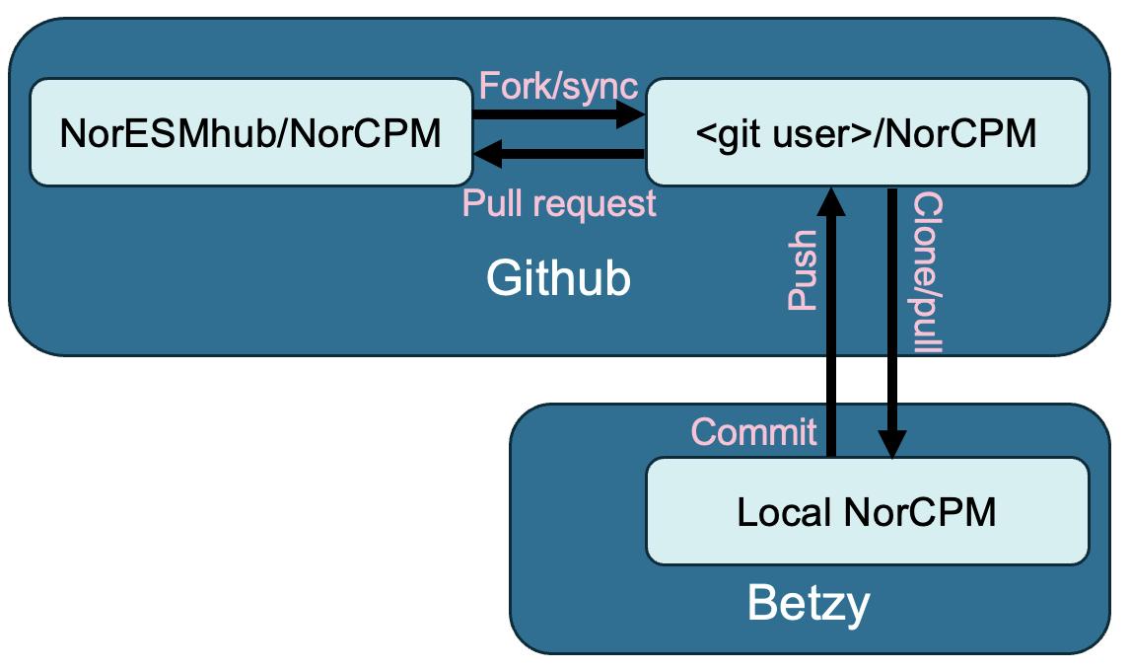
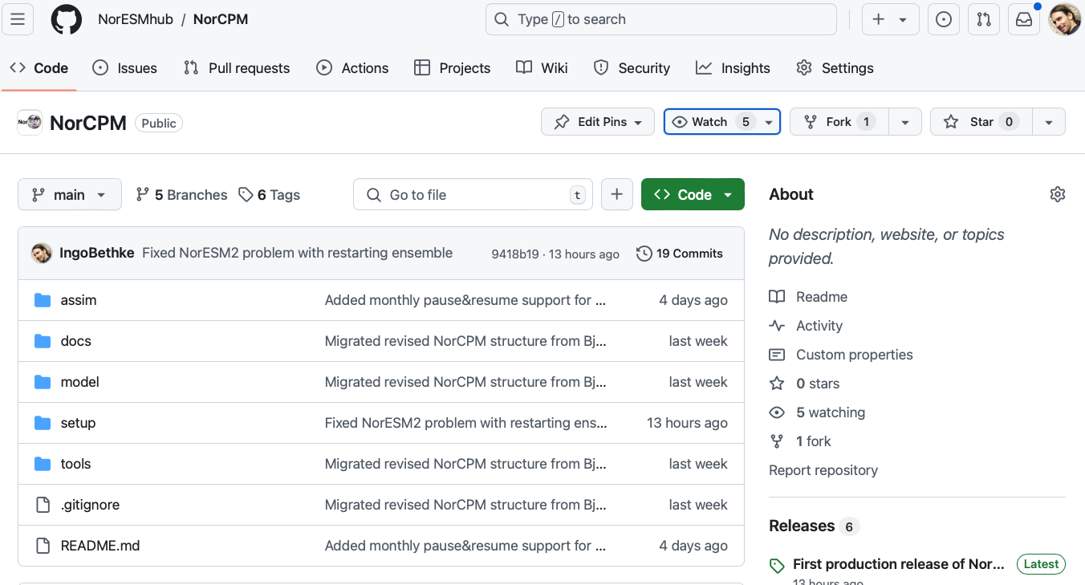
How to contribute to developing NorESMhub/NorCPM
Step 1: create fork NorESMhub/NorCPM in your personal github space

Slide 25
How to contribute to developing NorESMhub/NorCPM
Step 2: log on to Betzy and clone NorCPM from your personal github space
mkdir -p /cluster/projects/nn9039k/people/$USER
cd /cluster/projects/nn9039k/people/$USER
git clone ssh://git@github.com/<my github user>/NorCPM.git NorCPM
IMPORTANT: Before using ”ssh://git@github.com” form Betzy, create a public ssh-key on Betzy and upload the key to your github profile.

Slide 26
How to contribute to developing NorESMhub/NorCPM
Step 3: apply changes to your local NorCPM clone on Betzy

Slide 27
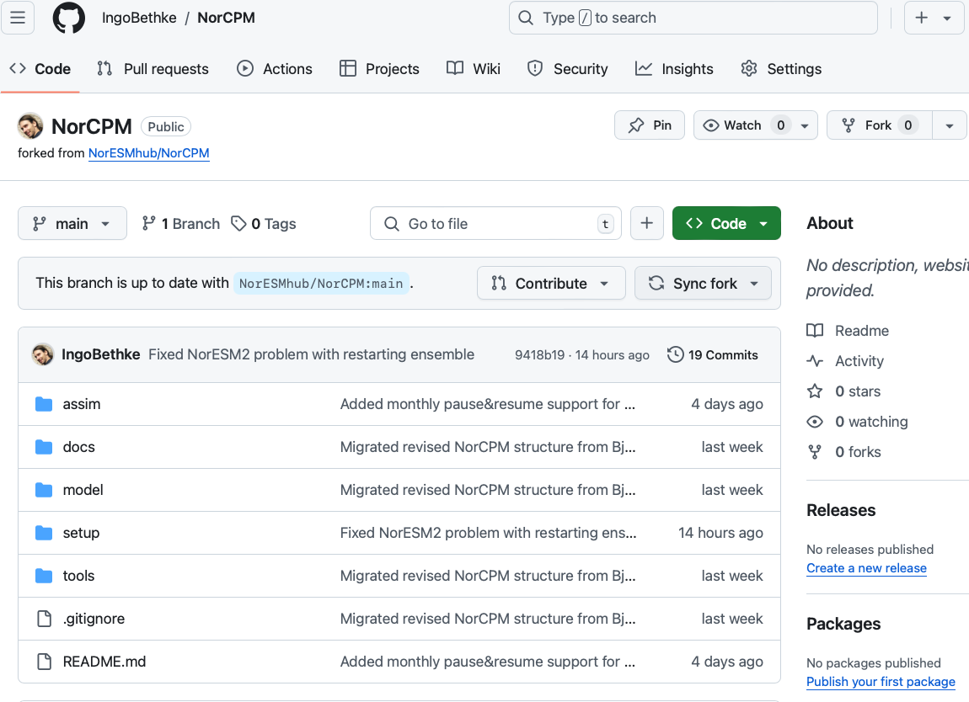
How to contribute to developing NorESMhub/NorCPM
Step 4: synchronize your fork with the latest NorESMhub/NorCPM state

Slide 28
How to contribute to developing NorESMhub/NorCPM
Step 5: synchronize your local NorCPM clone with your github fork
git pull

Slide 29
How to contribute to developing NorESMhub/NorCPM
Step 6: commit your changes to your local NorCPM clone
git add .
git status
git commit –m 'my commit message'

Slide 30
How to contribute to developing NorESMhub/NorCPM
Step 8: push changes from your local NorCPM clone to your github fork
git push

Slide 31
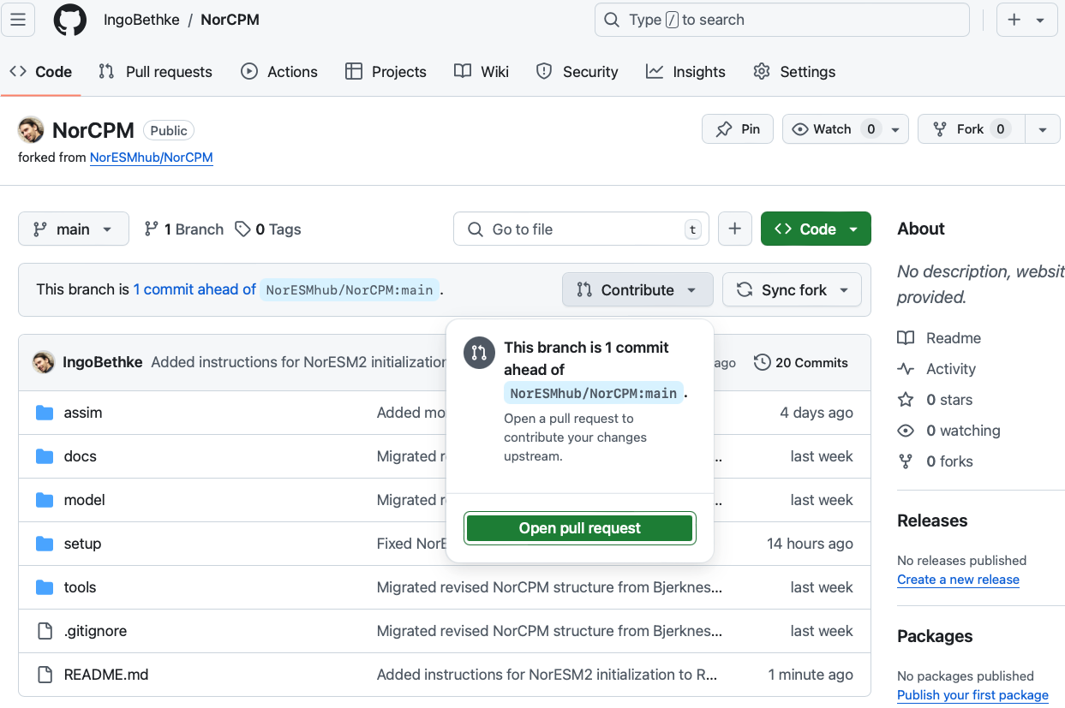
How to contribute to developing NorESMhub/NorCPM
Step 9: pull request for applying changes from fork to NorESMhub/NorCPM

Slide 32
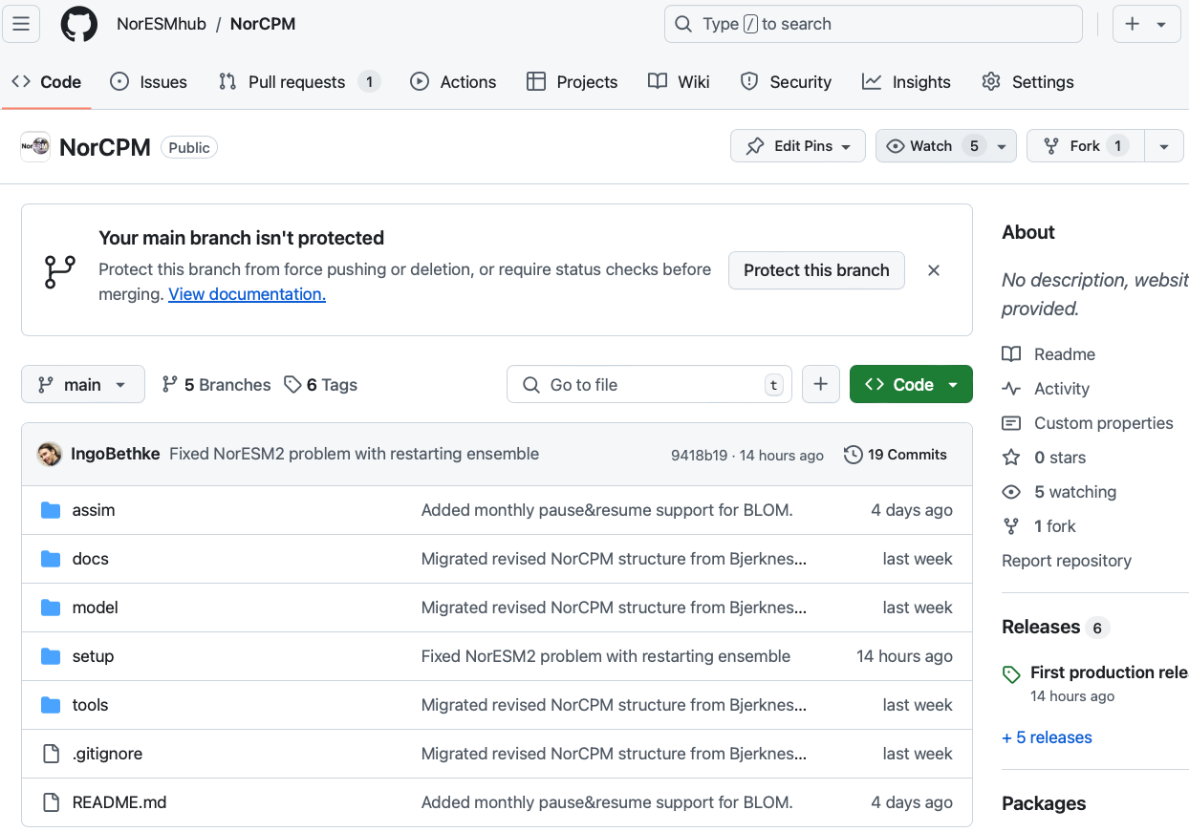
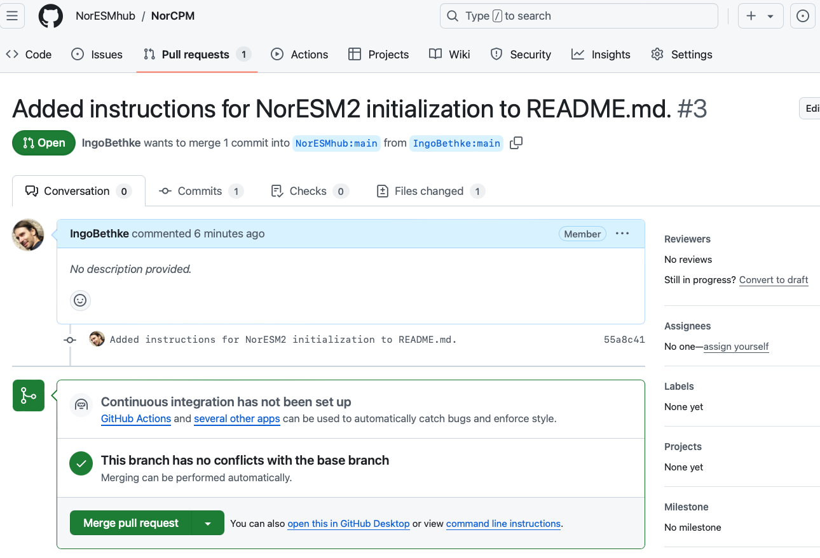
How to contribute to NorCPM
Step 10: merge pull request (only for maintainers)

Slide 33
Status
ready-to-use NorESM2 setup with daily SST assimilation and monthly T/S assimilation
initial conditions available for 10 members for years 1975, 1985, 1996, 2015
must switch from historical to scenario compset in 2015
git-workflow for contributing new developments
Coming soon
more restart members and restart dates for NorESM2-LM
combined historical-scenario compset that allows running 1850-2100
support for 1991-2020 reference period (in addition to 1980-2010)
«full-online» assimilation setup developed by Ping-Gin

